Slide 1
History 122 Midterm II Essay Suggestions
Possible ways of approaching the essay questions and the related ID’s

Slide 2
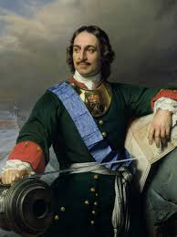
18th Century Rulers
For this essay, I’d expect to see comment on each of the following rulers:
France:
Louis XIV (14th)
Louis XV (15th)
Prussia
Frederick-William
Frederick the Great
Austria
Maria Theresa
Joseph II
Russia
Peter the Great
Catherine the Great
Prussia
Austria
Russia

Slide 3
18th Century Rulers
Be sure to evaluate each ruler. Were they enlightened? Not
so enlightened? Did they show a mixture of enlightenment and folly?

Slide 4
18th Century Thinkers
For this essay, I’d expect to see comment on each of
the following:
Diderot and his idea that existing knowledge can solve may of our problems
Condorcet and his idea that education will lead to all sorts of good things
Rousseau and his idea that reason can help us create a better political and social system. Be sure to discuss the Social Contract and the idea that a better system is on that will give us civil liberties in place of the natural liberties the formation of society destroys.
The Deists and their idea that we can sort of “edit” Christianity to come up with a reasonable religions
The Optimists and their idea that reason can solve difficult theological problems like the problem of evil
Voltaire and his ideas of what reason can and cannot do. Be sure to discuss Candide.
Kant and his ideas of what reason can and cannot do. Be sure to discuss the categorical imperative.

Slide 5
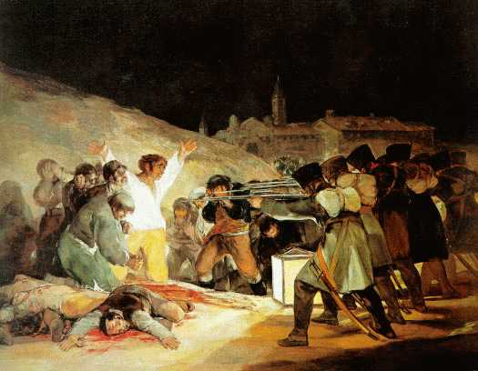
The French Revolution
I expect some mention of all four phases of the French Revolution discussed in class:
The National Assembly (1789-1792)
The Convention (1792-1795)
The Directory (1795-1799)
Napoleon (1799-1815)
In each case, be able to tell me the ways the French tried to improve their political/social system. Also tell me the actual results, and evaluate the “improvements.” Wonderful or not?
Note that I said far more about the first two phases and Napoleon than I did about the Directory. That section of your essay might be brief, but you should note that one of their reforms worked a bit too well!

Slide 6
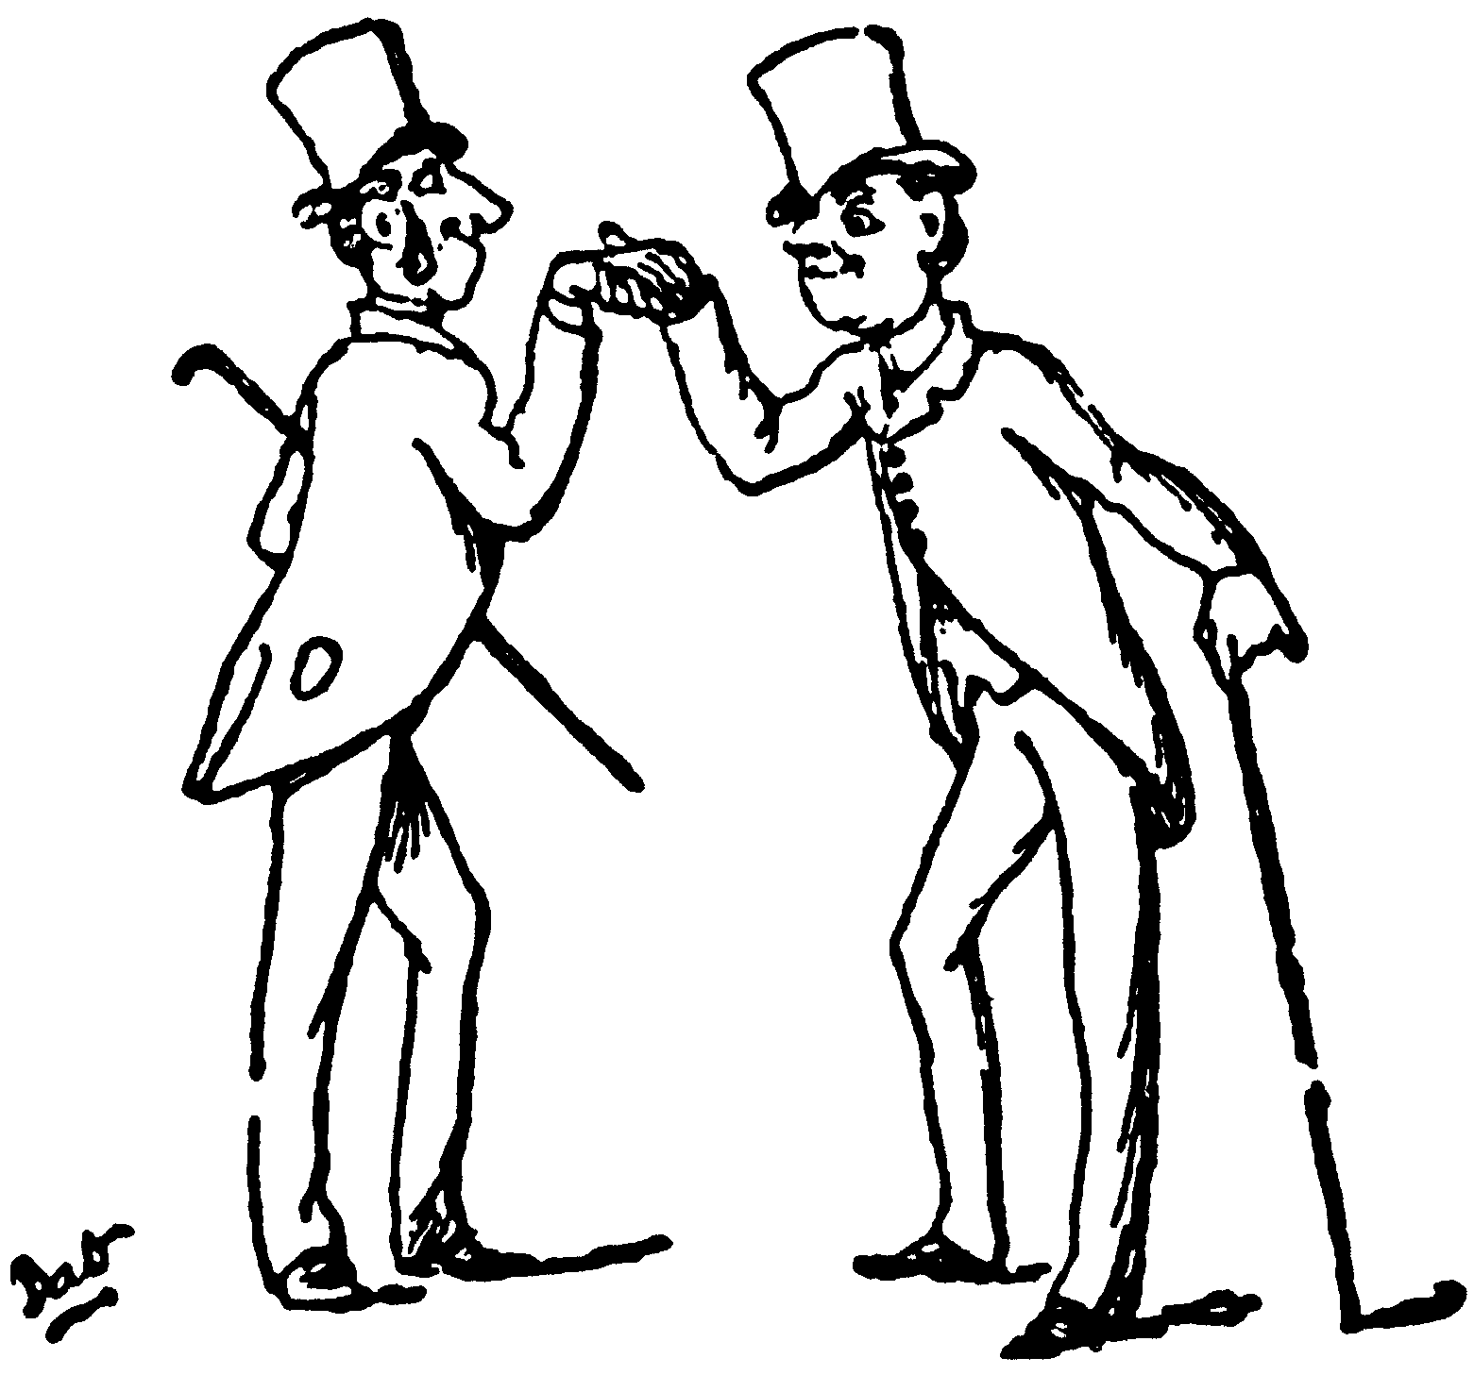
The Age of Progress
On this essay, I’d like to see the following:
A discussion of the conservative ideas that prevailed during the first half of the 19th century. Be sure to talk about the Congress of Vienna and the Holy Alliance.
A discussion of the liberal ideas that encouraged a challenge to the status quo. Be sure to talk about both nationalism and laissez-faire economics.
19th century France
19th century Italy
19th century Germany
19th century Britain
Be sure to note whether each country was making progress and, if so whether that progress came from conservative ideas, liberal ideas, both conservative and liberal ideas—or neither!

Slide 7
Europe and the World The White Man’s Burden
Lot’s of flexibility here. You can talk about European influence on the peoples of other continents (the Americas, Africa, Australia, and Asia). However, you can instead just comment of Africa and Asia. I’d expect some mention of what Leopold II did in the Congo. I’d also expect comment on European influence on China and India.
This is really a thought/evaluation question. What was this White Man’s burden? Was it in any way justified? Which, if any, of the changes made by the Europeans seems to have been good at least in the long term? What short-term problems did it create? Was it right for the British to work to eliminate temple prostitution, Sati, the Thugs, and infanticide in India? What about the introduction of European technology, European-style education, etc?

Slide 8
Europe and the World The White Man’s Burden
Similar questions when it comes to China. The Opium War and the imperialistic division of China into spheres of influence is hard to justify. But what over the other changes? Was it right to open the door to Christian missionaries? To extend educational opportunities? To try to raise the status of women be eliminating foot binding and child marriage. Was it right to try to curtail infanticide, drug and alcohol abuse, and witchcraft?
Be sure to note the problems created by Chinese who *embraced* European ideas. Note Hong Xiuquan’s Taiping Rebellion—and the 10-50 million deaths that followed.
You can certainly stop with 19th century India and China, but, if you like, you can comment favorably or unfavorably about the adoption of Western ideas and technology in the 20th century.

